Slide 1
Batch-11
PGP-DSE-feb-2022
Interim-Presentation

Slide 2
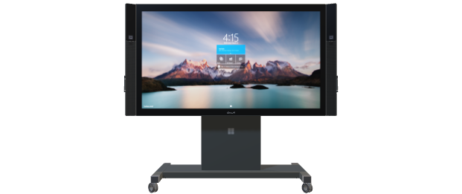
Project Summary
Batch details DSE – MARCH 2022 (CHENNAI)
Team members Vigneshwar K ,TamilSelvan M, Balaji Prasanth S, Rahul R ,Adarsh R
Domain of Project E-Commerce (Supply Chain)
Proposed project title Backorder Prediction
Group Number Team 11
Team Leader Vigneshwar K
Mentor Name Pratik Sonar

Slide 3
Problem Statement
Part backorders is a common supply chain problem, wherein a customer places an order for a product that is temporarily out of stock. The percentage of items backordered and the number of backorder days are important measures of the quality of a company's customer service and the effectiveness of its inventory management.
A company can manage its inventory more efficiently using a prediction on the backorder risk for the products. Goal here is to use the past data and metadata around the backorders, and provide a prediction on the potential products for backorders.

Slide 4
Client
Sigma Retails Ltd is a leading online store providing products ranging from clothing, home improvements to grocery. Recently, client has been finding it difficult to manage the backorders, resulting into increasing customer issues and a decline in customer satisfaction.
Client is looking for ways to improve backorders handling. With the help of this analysis, a reasonable prediction on the products that can go on backorder is expected. Such a prediction could immensely help client to plan for a more effective stocking and backorder handling.

Slide 5
Data Description
S.No | Feature Name | Feature Description
1. | national_inv | Current inventory level for the part
2. | lead_time | Transit time for product (if available)
3. | in_transit_qty | Amount of product in transit from source
4. | forecast_3_month | Forecast sales for the next 3 months
5. | forecast_6_month | Forecast sales for the next 6 months
6. | forecast_9_month | Forecast sales for the next 9 months
7. | sales_1_month | Sales quantity for the prior 1-month time period
8. | sales_3_month | Sales quantity for the prior 3-month time period
9. | sales_6_month | Sales quantity for the prior 6-month time period
10. | sales_9_month | Sales quantity for the prior 9-month time period
11. | min_bank | Minimum recommend amount to stock
12. | potential_issue | Source issue for part identified
13. | pieces_past_due | Parts overdue from source
14. | perf_6_month_avg | Source performance for prior 6 month period
15. | perf_12_month_avg | Source performance for prior 12-month period
16. | local_bo_qty | Amount of stock orders overdue
17. | deck_risk | Part risk flag
18. | oe_constraint | Part risk flag
19. | ppap_risk | Part risk flag
20. | stop_auto_buy | Part risk flag
21. | rev_stop | Part risk flag

Slide 6
VARIABLE CATEGORIZATION :
Independent variables:
Numerical column: 15
Categorical column: 7
Target variable:
Categorical - 1
Total columns: 23

Slide 7
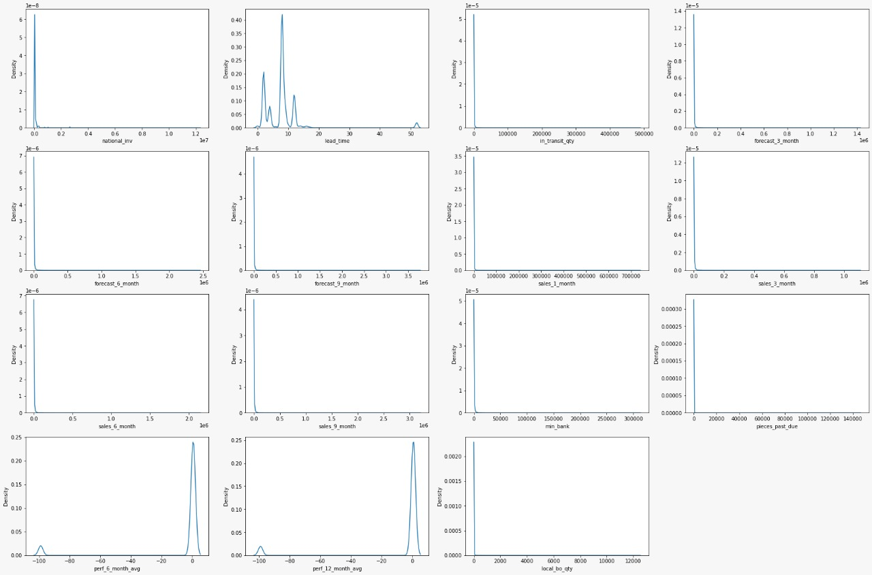
Distribution of variables

